Slide 1

Assginment 4 of bdat 1007
Danhong Tang:200471292 Date:08/04/2021
Youtube: http://youtu.be/RPJBakxLRDM?hd=1

Slide 2
To do list
Create a new project
Create tags and choose training images
Upload and tag images
Train the classifier
Evaluate the classifier
Pre-requisite
Collect more than 7 pictures for each category

Slide 3
DISPLAY OF LIVE MEDO

Slide 4
Tips --------- 2.Create tags and choose training images
Select images with variety from:
camera angle
lighting
background
visual style
individual/grouped subject(s)
size
type
Format criteria:
.jpg, .png, .bmp, or .gif format
no greater than 6MB in size (4MB for prediction images)
no less than 256 pixels on the shortest edge; any images shorter than this will be automatically scaled up by the Custom Vision Service

Slide 5
Tips --------- 5.Evaluate the classifier
Precision
indicates the fraction of identified classifications that were correct.
Recall
indicates the fraction of actual classifications that were correctly identified.
AP
is the average value of the average precision (AP).
Probability threshold
This is the level of confidence that a prediction needs to have in order to be considered correct (for the purposes of calculating precision and recall).

Slide 6
COMPARISOM
(How number of pictures influence the result)

Slide 7
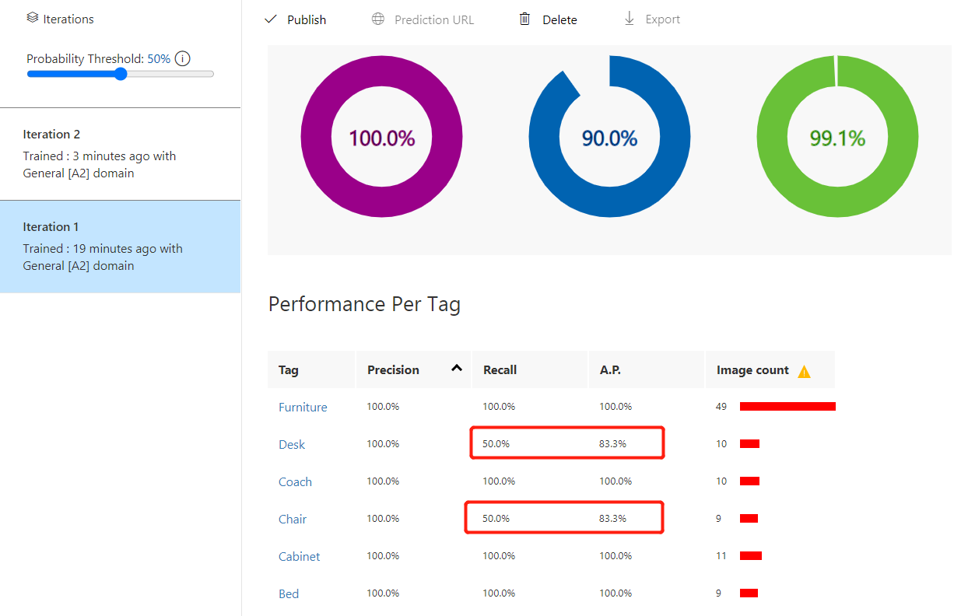
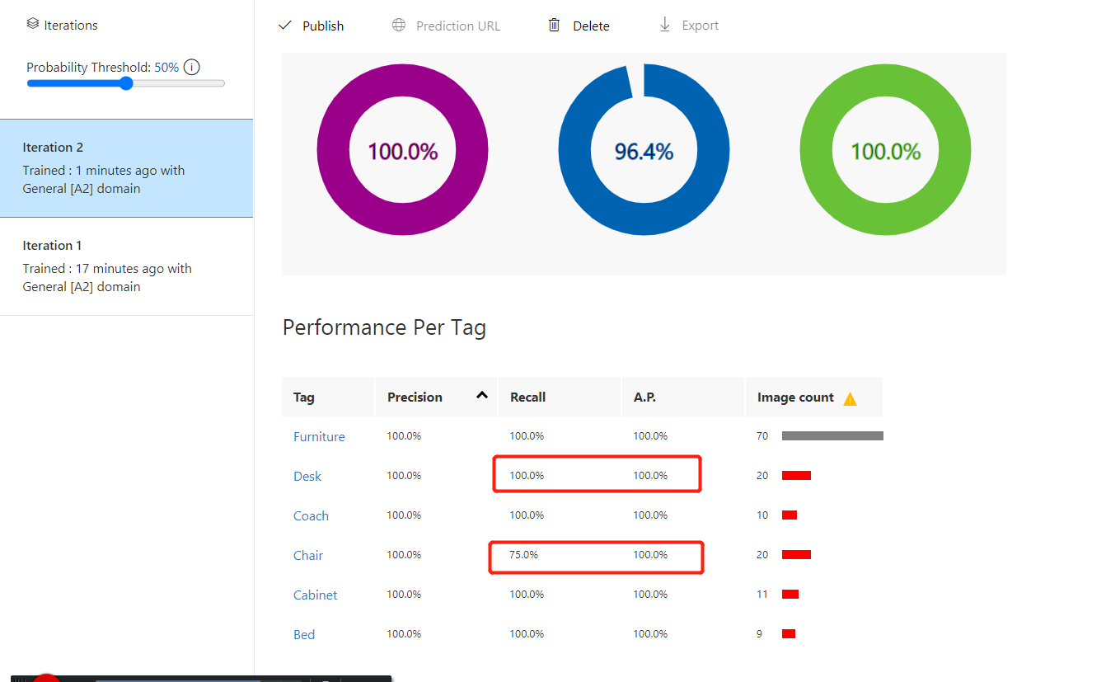
Comparison of training

Slide 8
CONCLUSION
It can detect several items in a pic.
It can detect item blending classifications of different tags and give number of each one tag seperately.
Need to compare data under the same Probability Threshold(a high probability threshold, they tend to return results with high precision but reduce Recall number; A low probability threshold does the opposite—it can recognize more pictures but with lower precision. ).
Add more pictures to a certain tag can improve individual and total Recall and AP .

Slide 9
THANKS

